Slide 1



SpeechSpectrum
An AI-powered tool for early screening of
autism-linked speech delays in children.

Slide 2


Vision
To revolutionize early childhood developmental screening by delivering an AI-powered platform that enables parents to detect Autism risk early through smart questionnaires and voice analysis reducing delayed diagnosis and improving long-term outcomes.

Slide 3

1. Problem identification
Early speech delay is common in young children, often linked to Autism Spectrum Disorder (ASD), which is difficult to detect early. Parents frequently miss the subtle signs, such as limited vocabulary or delayed gestures, resulting in the loss of critical opportunities for early intervention. This is compounded by the fact that the formal diagnosis process is currently slow, costly, and inaccessible for many families, creating significant barriers to timely and effective care.

Slide 4

Who Faces This Problem?
• Parents and caregivers lack awareness and proper screening tools
• Children (ages 1–10) miss early diagnosis opportunities
• Limited availability of specialists causes delays

Slide 5

Why it matters?
• Early intervention is critical for cognitive and communication development
• Delayed diagnosis leads to missed developmental milestones
• Traditional screening methods are time-consuming, costly, and inaccessible

Slide 6
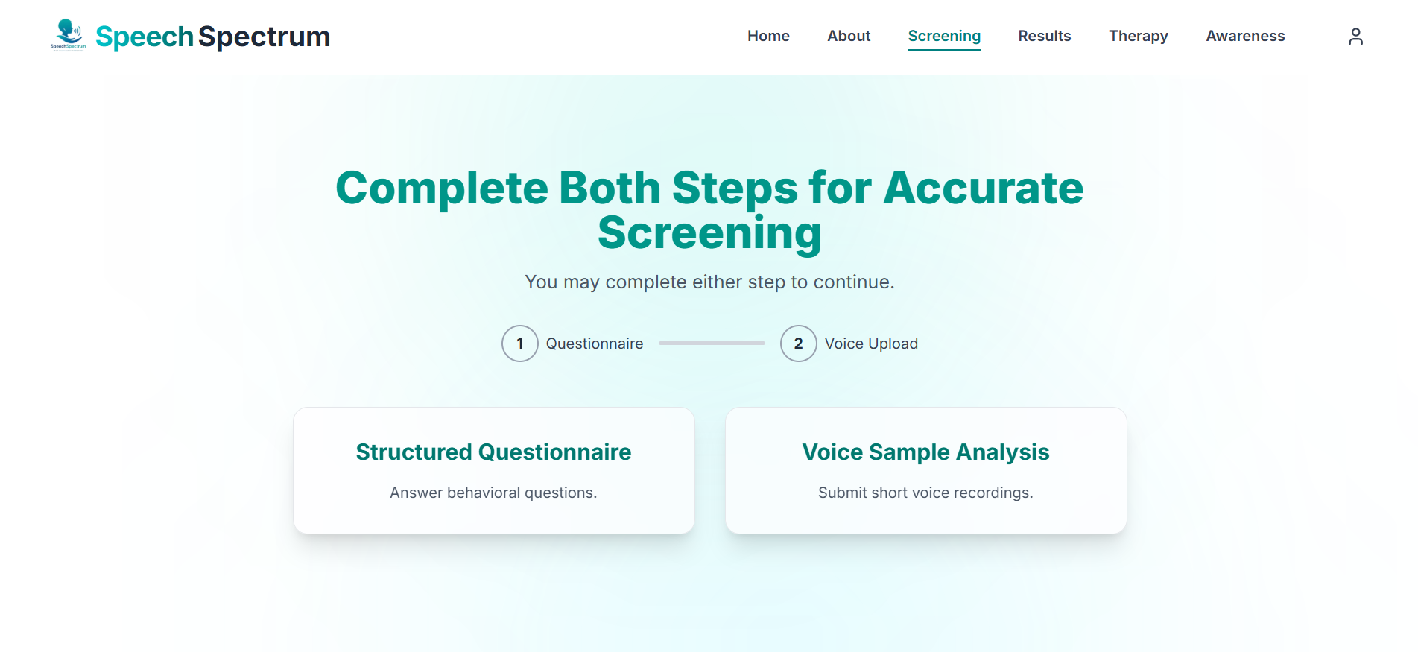
3. Solution addressed
Developed an AI-powered early ASD screening platform for accessible at-home use.
Integrated a Q-CHAT questionnaire-based ML model (ages 1–3) with ~95–96% validation accuracy.
Built a speech analysis ML module (ages 4–11) to detect ASD-related speech delay patterns.
Provides probability-based risk assessment, not medical diagnosis, encouraging timely professional consultation.
Designed with scalable backend architecture (Flask API + deployed ML models) for future expansion and real-world deployment.

Slide 7
4. Unique Value Proposition (UVP)
SpeechSpectrum uses AI, multimodal screening, and speech analysis to detect autism risk early, providing parents and caregivers with reliable insights and guidance before delayed diagnosis becomes a barrier.

Slide 8
Key Benefits
• Saves Time – Instant screening without long waiting periods
• Cost-Effective – Reduces dependency on expensive initial assessments
• Accessible – Can be used anytime, anywhere by parents
• Accurate & Insightful – AI-based analysis provides reliable risk insights

Slide 9
Why Users Will Prefer Our Solution?
• Early detection at home without medical complexity
• One-stop solution: screening + expert consultation
• User-friendly platform designed for parents and caregivers
• Faster, smarter, and more accessible than traditional methods

Slide 10


5. Market Opportunity
Target customers/users
• Parents and caregivers of children (ages 1–10)
• Pediatricians, therapists, and healthcare professionals
• Schools and early childhood learning centers

Slide 11
Market Sizing
TAM
Total Addressable Market
The global market for early childhood developmental screening represents a multi-billion-dollar opportunity, driven by millions of children aged 1–11 requiring early detection of developmental disorders.
With Autism Spectrum Disorder (ASD) affecting approximately 1 in 36 children, the demand for accessible and scalable screening solutions is rapidly increasing across parents, healthcare providers, schools, and public health systems worldwide.

Slide 12
Market Sizing
2. SAM
Serviceable Available Market
The portion of the market we can serve digitally through a web-based AI screening platform, targeting:
Urban parents with internet access
Pediatric clinics
Early childhood education centers
Initially focused on regional/national deployment (e.g., Pakistan or South Asia) where early screening accessibility is limited and diagnosis delays are common.

Slide 13
Market Sizing
3. SOM
Serviceable Obtainable Market
The realistic share we aim to capture in the first 3–5 years through:
Direct-to-parent digital subscriptions
Partnerships with preschools and pediatric clinics
Institutional licensing
Initial goal: capture a small percentage of urban parent users and early education institutions through pilot programs and incubation partnerships.

Slide 14
6. Business Model
Revenue streams (subscription, ads, etc.)
Pricing strategy
How the startup will sustain itself

Slide 15
Revenue Streams
SpeechSpectrum’s Revenue will be subscription-based focused.
Basic Plan
Target: Parents and caregivers
Includes:
Access to questionnaire-based screening
Limited speech sample analysis
AI-generated autism risk score
Premium Plan
Target: Parents seeking detailed insights and tracking
Includes:
Multi-child management dashboard
Comprehensive speech and behavioral analysis
Detailed risk assessment reports
Progress tracking and developmental recommendations
Secure patient-doctor data sharing portal
Batch screening & reporting

Slide 16
Pricing & Sustainability
Pricing Strategy
Sustainability
Low-cost entry to encourage mass adoption
Tiered pricing (basic → premium features)
Affordable plans tailored for developing markets
Optional pay-per-consultation for expert sessions
Recurring revenue through subscriptions
Scalable digital platform with low operational cost
Continuous user growth via awareness and partnerships
Expansion into telehealth and AI-based healthcare services

Slide 17
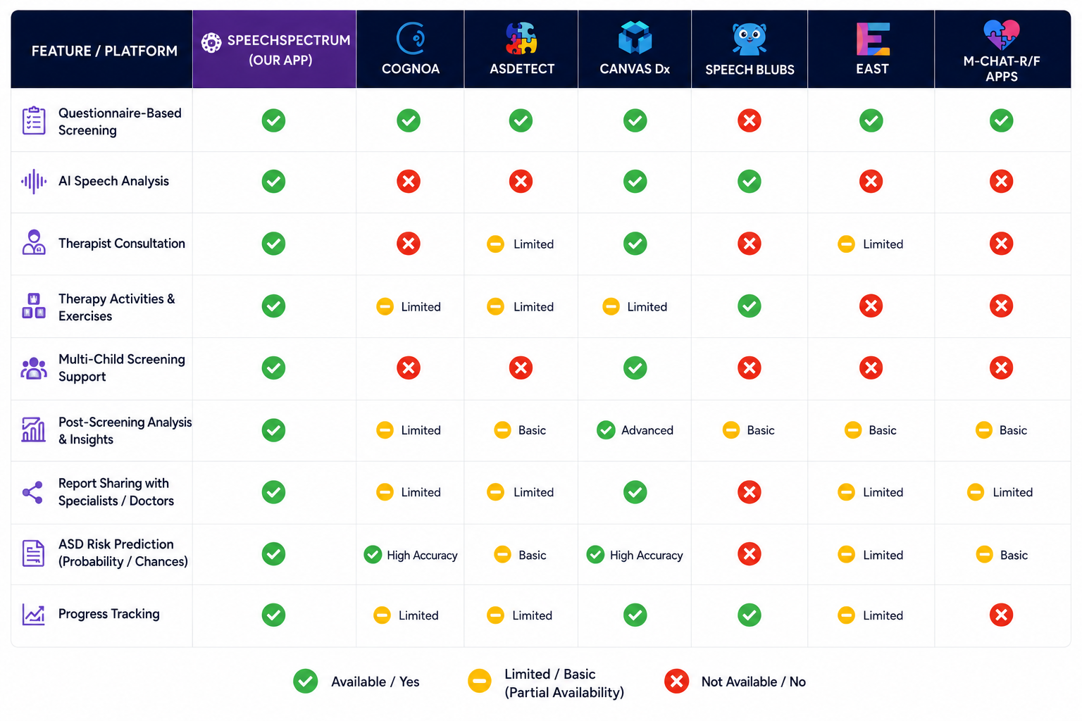
7. Competitive Analysis / Existing Alternatives

Slide 18
8. Technology & Innovation
Tech Stack
Frontend
Mobile: Flutter (iOS & Android)
Web: Next.js
Backend & Data
API: FastAPI / Flask , NodeJS & Express
Database: Supabase
Intelligence
ML Models:
TensorFlow Lite, Random Forest, CNN
Cloud & Deployment
Digital Ocean & Vercel
Design Tools
Figma

Slide 19
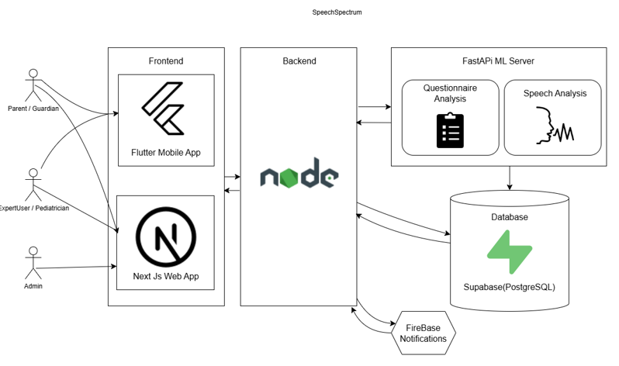
System Overview

Slide 20
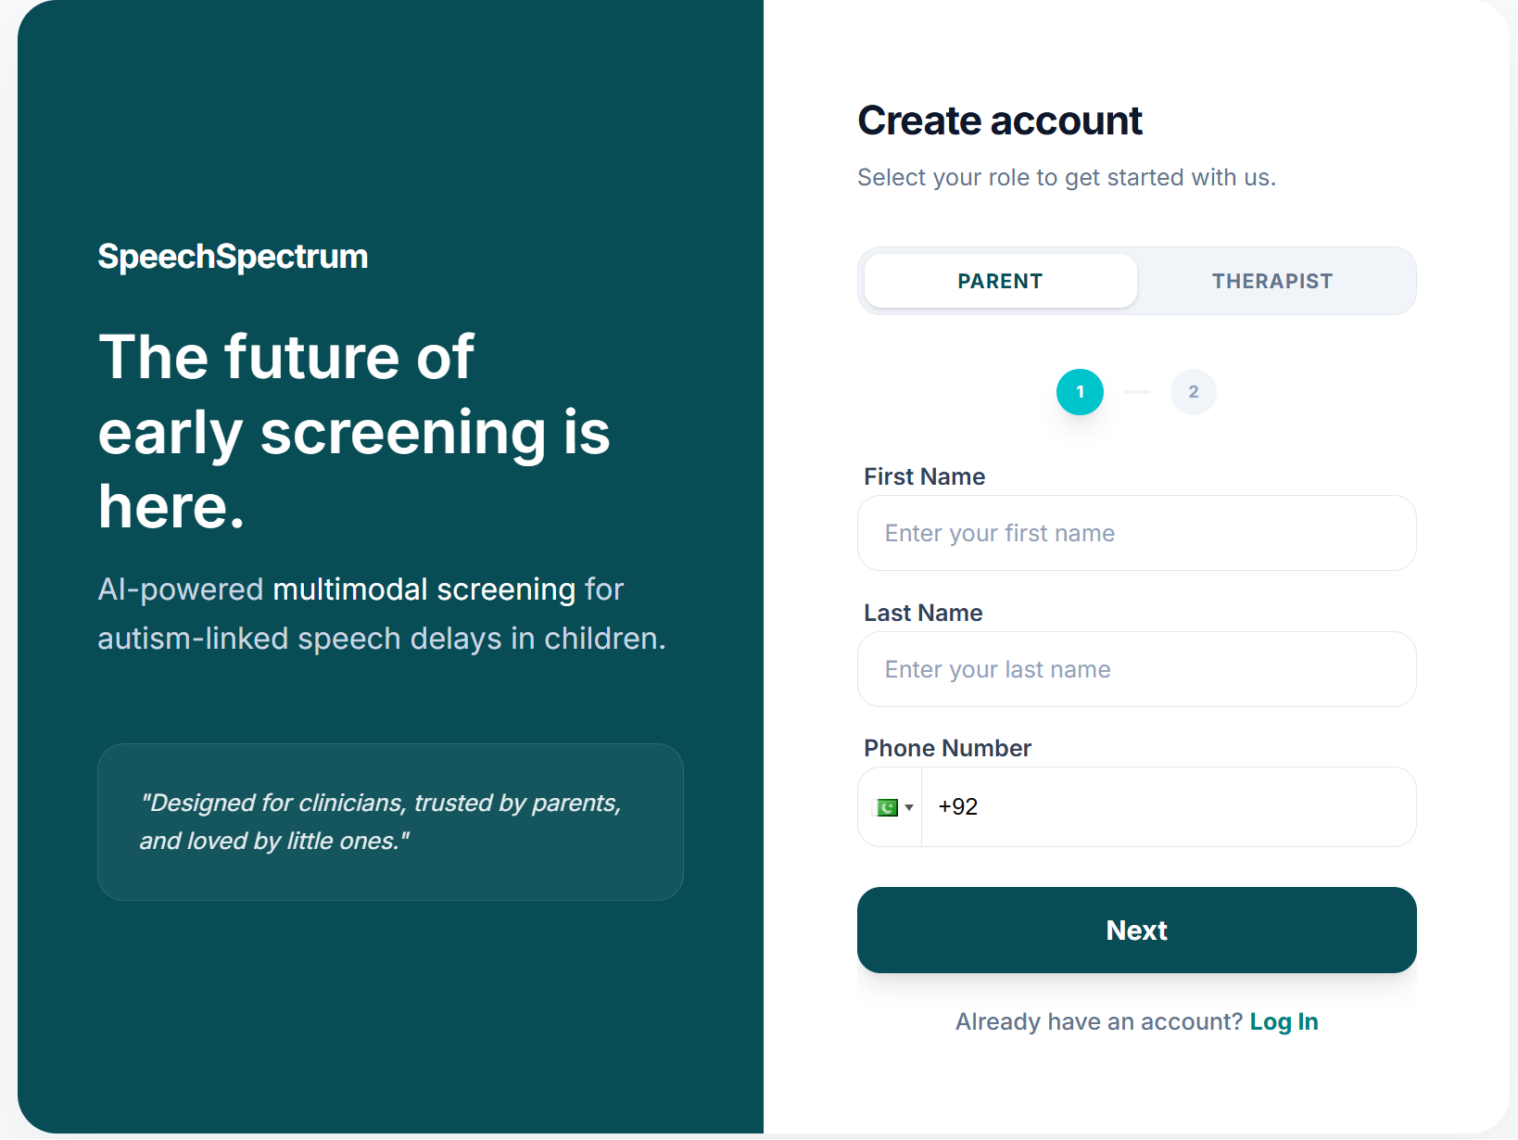
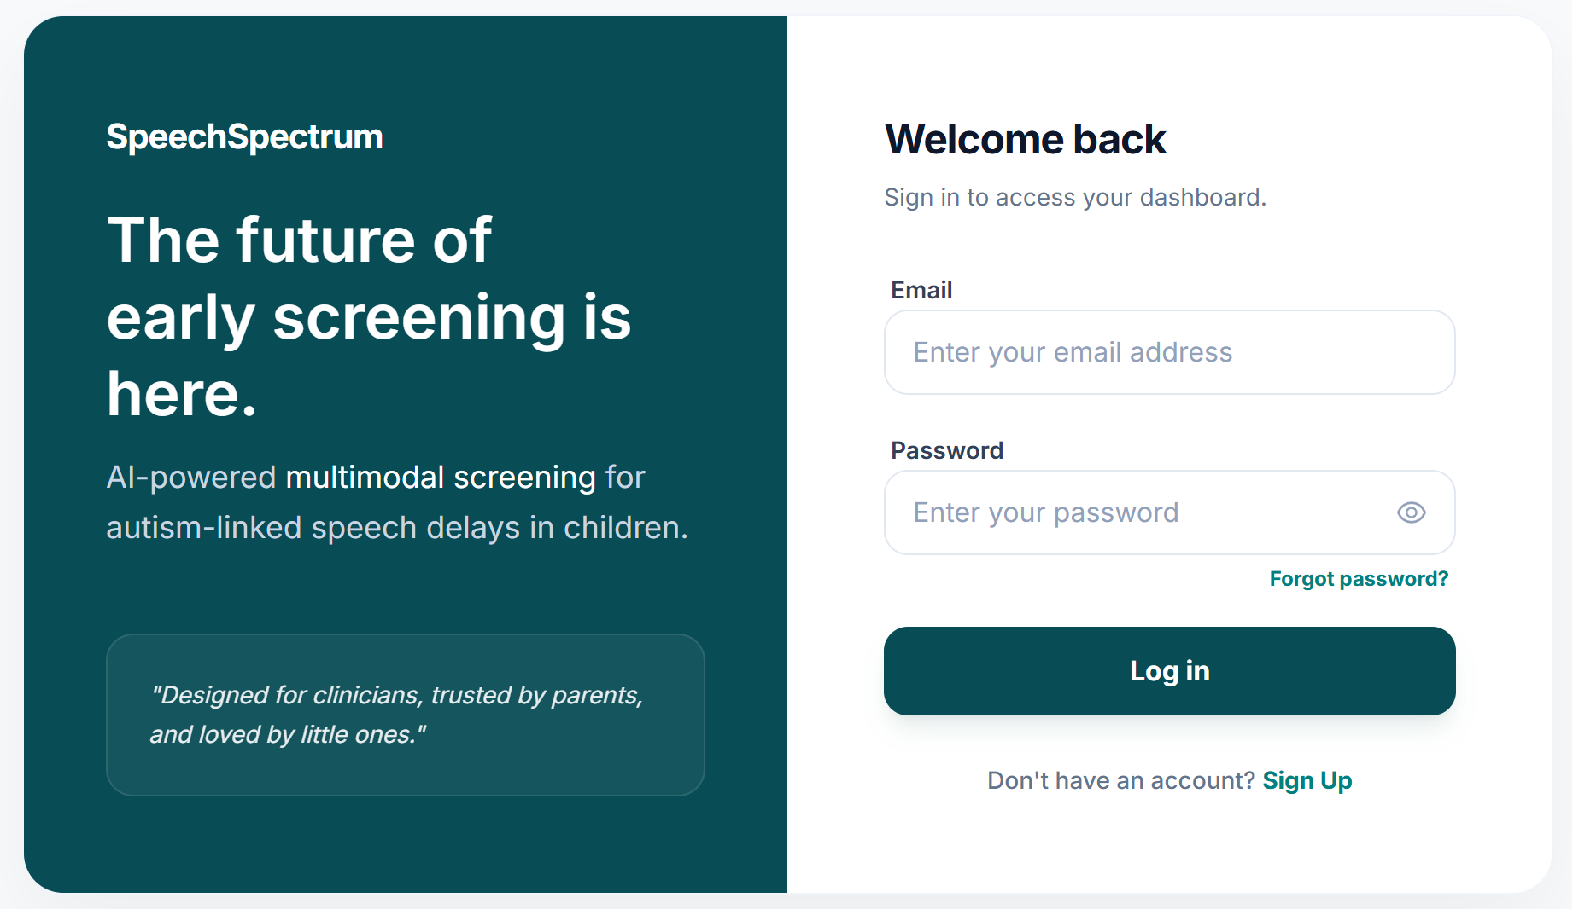
9. Product Demo
Login / Signup Screen

Slide 21
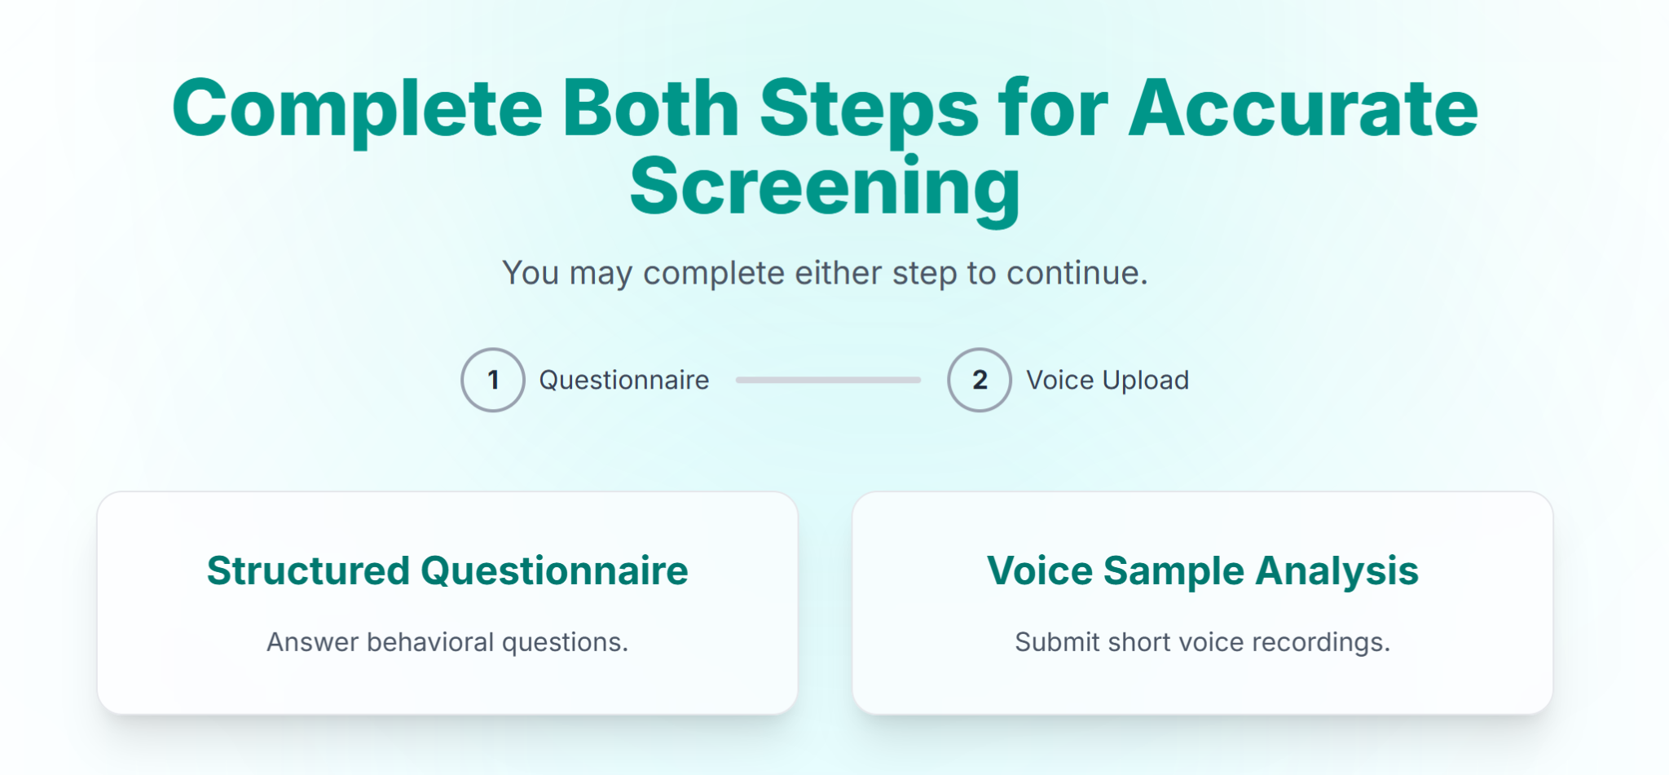
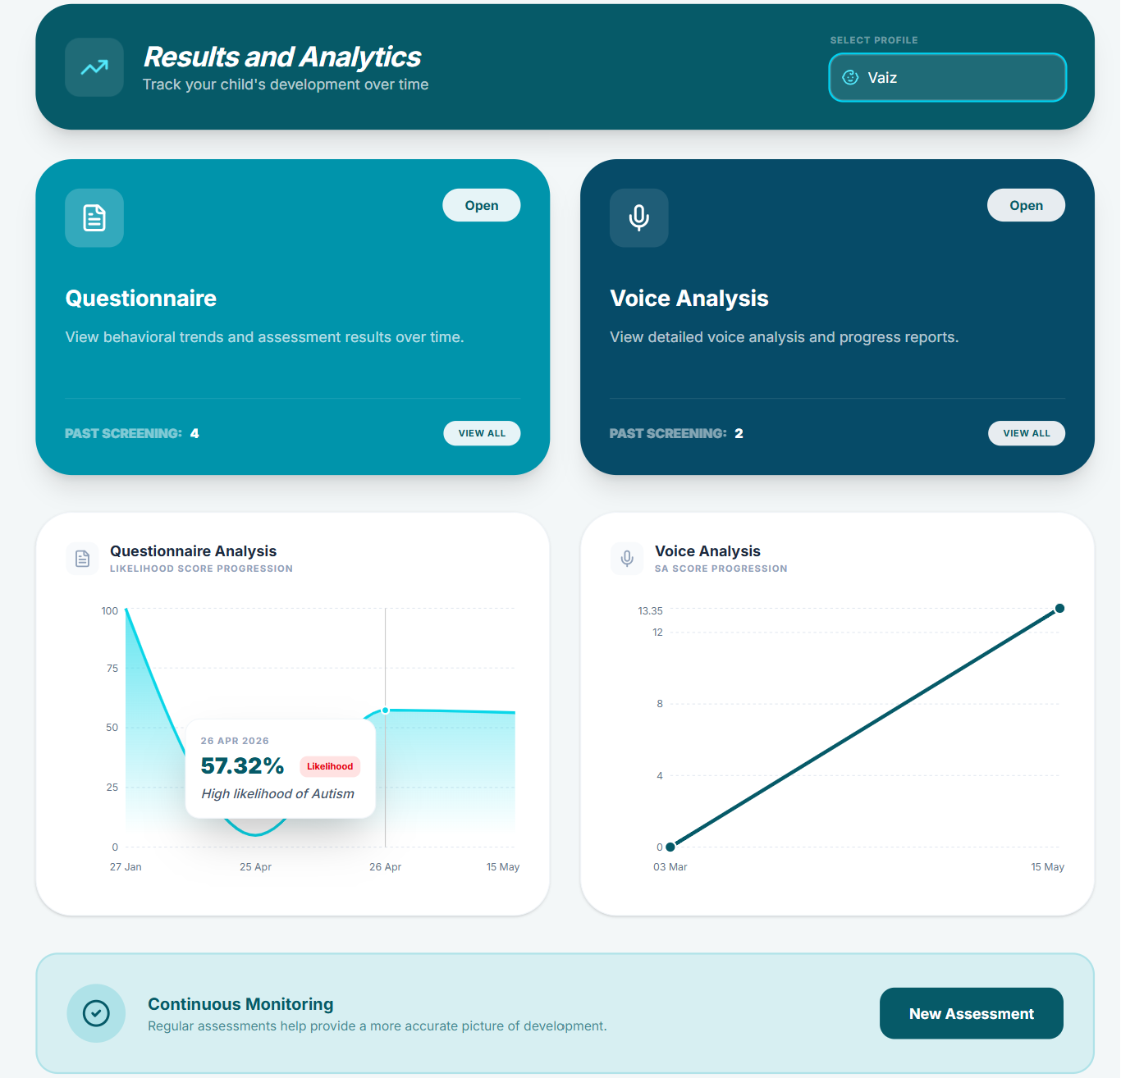
9. Product Demo (Continued)
Dual-Step Screening Interface
Results & Analytics Interface

Slide 22
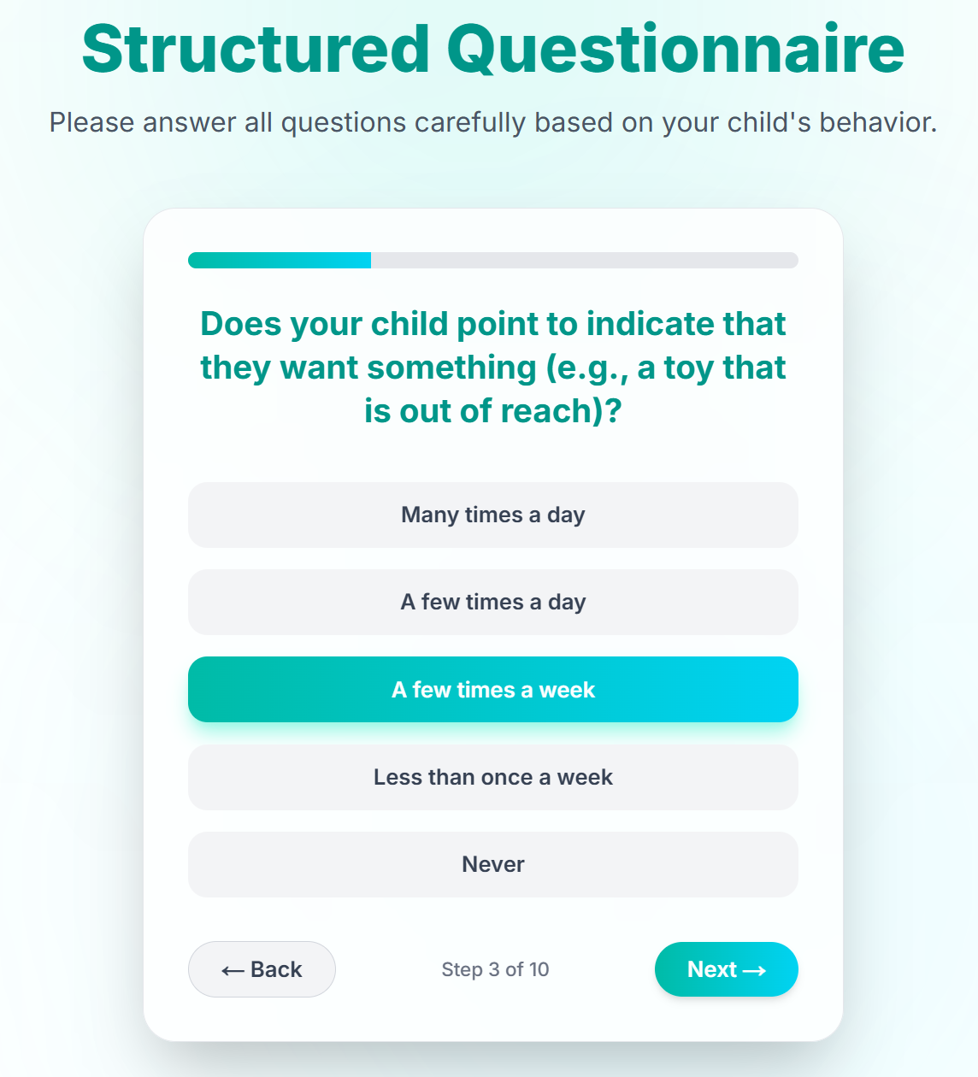
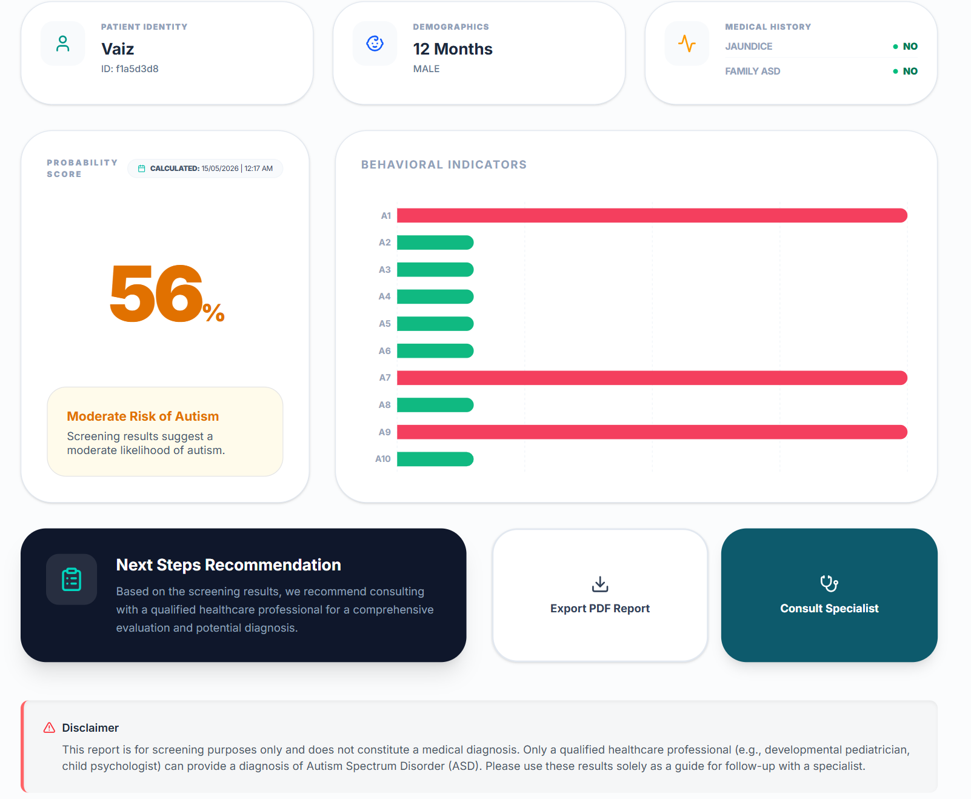
9. Product Demo (Continued)
Questionnaire Interface
Questionnaire Results

Slide 23
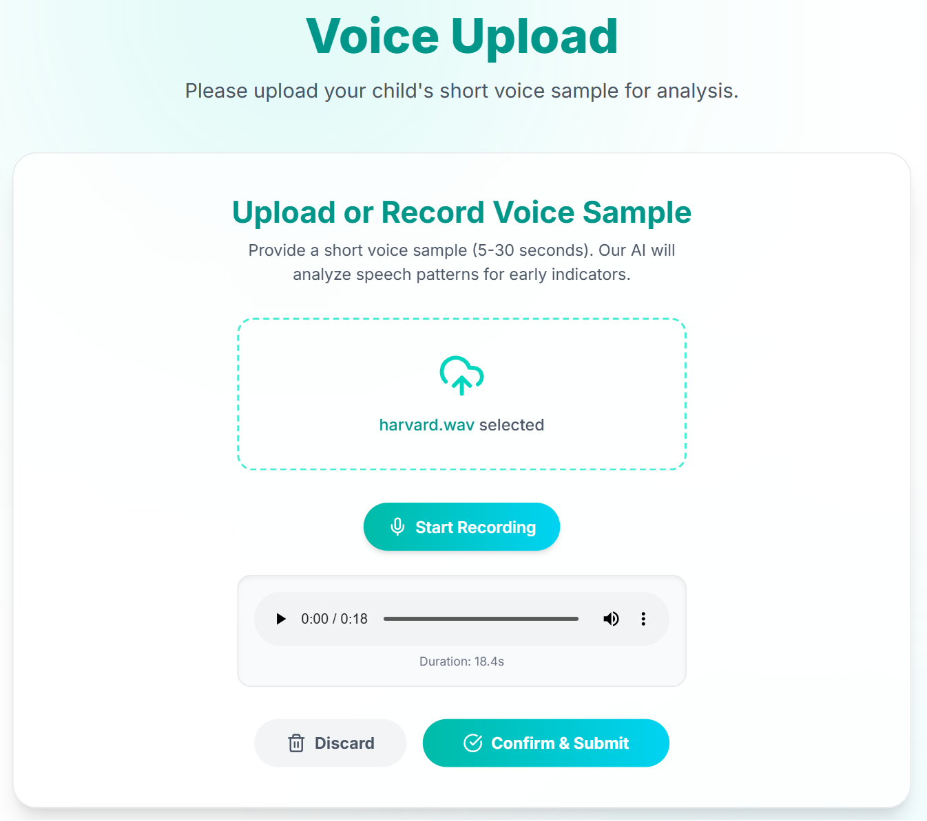
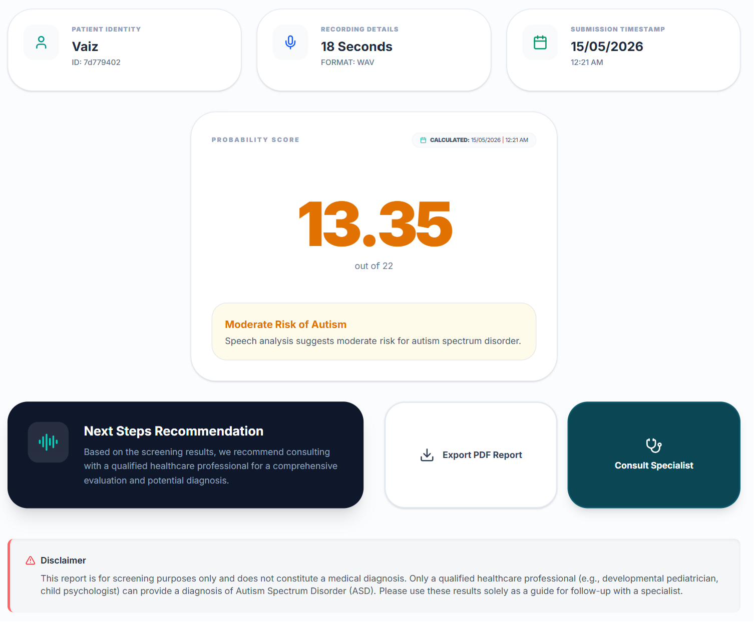
9. Product Demo (Continued)
Voice Analysis Interface
Voice Analysis Results

Slide 24
9. Product Demo (Continued)
User Flow
User registers / logs in
Creates child profile
Completes behavioral questionnaire
Records child’s speech sample
Dual AI analysis (questionnaire + speech modules)
Generates independent autism risk screening scores
Provides therapy exercises, consultation support, and next-step guidance

Slide 25
10. Go To Market Strategy
Marketing Channels
Social media marketing (Instagram, TikTok, Facebook, LinkedIn)
Educational content & awareness campaigns
Google & Meta ads targeting parents
Partnerships with therapists, clinics & schools
Customer Acquisition
Free initial ASD screening (Basic model)
Therapist onboarding & consultation support
Referral-based growth from parents & specialists
Multi-child screening for schools & clinics
User retention through progress tracking
Launch Strategy Roadmap
Phase 1 — Testing
Internal testing & AI model validation
Phase 2 — Pilot
Beta release for parents & therapists
Collect feedback & improve features
Phase 3 — Public
Launch web & mobile applications
Start digital marketing campaigns
Phase 4 — Expansion
Add multilingual support & analytics
Expand healthcare partnerships

Slide 26
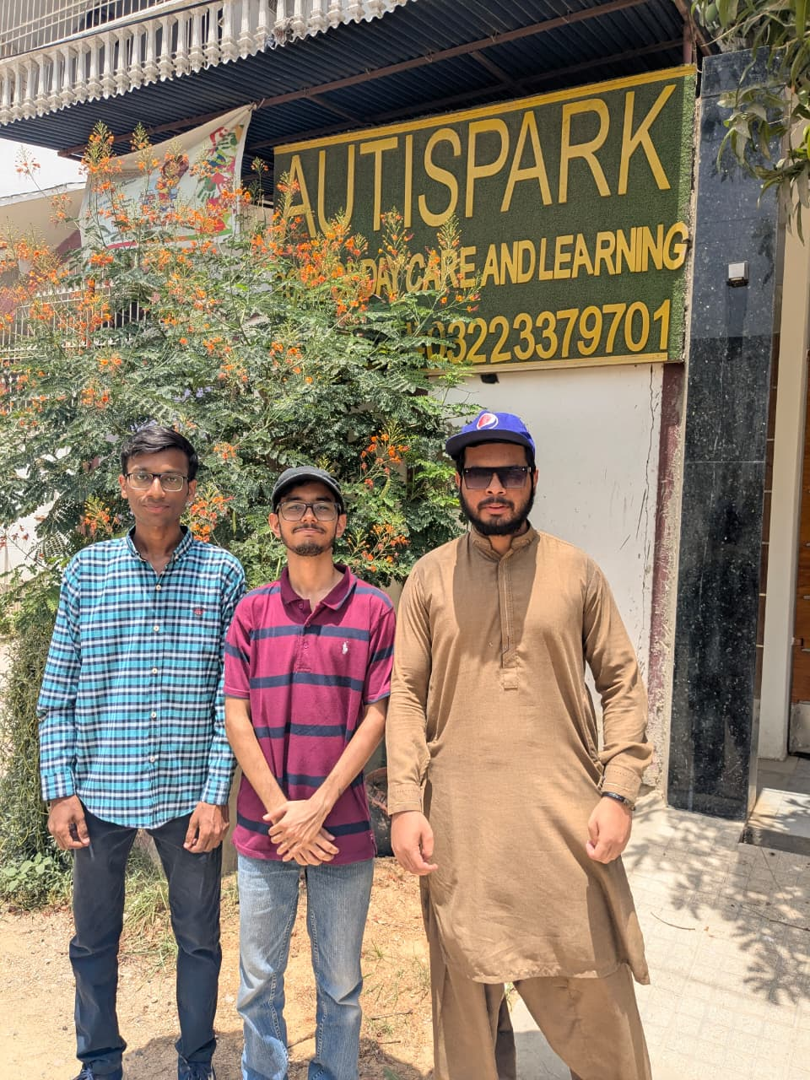
11. Traction / Validation
Real-World User Testing
Conducted on-site validation at AutiSpark Centre
Observed and tested with real users in a clinical/support environment
Collected practical feedback from caregivers and professionals
Validated usability of questionnaire and voice-based screening flow
Evidence of Demand
Autism Spectrum Disorder affects approximately 1 in 127 people globally — World Health Organization (WHO) Source: https://www.who.int/news-room/fact-sheets/detail/autism-spectrum-disorders
In Pakistan, approximately 1 in 100 children is estimated to have Autism Spectrum Disorder (ASD) — Dawn Newspaper Source: https://www.dawn.com/news/1906782
Around 350,000 children in Pakistan are estimated to be living with autism, many of whom remain undiagnosed — Dawn Newspaper Source: https://www.dawn.com/news/1703083

Slide 27
12. Financials Overview:
Cost Structure:
Monthly Recurring OPEX
Infrastructure & Services
CNN Model Deployment (DigitalOcean) ~ PKR 7k–8k
Frontend/Backend Hosting (Vercel) ~ PKR 12k–14k
Supabase Pro Database & Auth ~ PKR 7k–8.5k
Cloudinary Media Storage ~ PKR 5k–12k
Payment Gateway Charges ~ PKR 3k–10k
Domain & Misc. Services ~ PKR 3.5k–8k
Total Estimated Monthly OPEX
PKR 39,500 – 55,500
Operational Expenditure (CAPEX)
One-Time & Annual Setup Costs
Development Laptops / Hardware ~ PKR 180k–450k
Testing Devices (Android/iOS) ~ PKR 50k–200k
UI/UX Design & Branding ~ PKR 15k–40k
SSL / Security Setup ~ PKR 5k–15k
Marketing Cost ~ PKR 5k–15k
SEO Optimization Cost ~ PKR 10k–20k
Domain Registration ~ PKR 3k–8k
Total Estimated One Time Capex
PKR 268,000 – 748,000

Slide 28

Revenue Projection
Year 1 (Initial Launch)
Year 2 (Growth Phase)
Year 3 (Scaling Phase)
500+ Basic Plan users
100+ Premium Plan subscriptions
Early partnerships with clinics & therapists
Estimated Revenue:
PKR 0.8M – 1.5M
Expansion across Pakistan & South Asia
Increased parent adoption through campaigns
Institutional subscriptions (schools/clinics)
Estimated Revenue:
PKR 3M – 6M
Enterprise dashboard adoption by healthcare
Growth in consultation commissions
Expansion into telehealth & AI services
Estimated Revenue:
PKR 8M – 15M
Future Revenue Opportunities
• Institutional subscriptions for schools & clinics
• Therapist consultation commissions
• Healthcare partnership integrations
• Enterprise dashboards for organizations

Slide 29
13. Roadmap
Short Term
0-6 months
Complete testing and final model validation
Deploy full production version
Onboard first cohort of parents and collect real-world screening data
Build user base through digital outreach and parenting communities
Mid Term
6-12 months
Launch Basic and Premium subscription plans
Establish partnerships with clinics and therapy centers
Improve model accuracy using newly collected real-world data
Begin B2B outreach to preschools and daycare networks
Long Term
12-24+ months
Expand into international markets with limited ASD infrastructure
License screening API to pediatric platforms and NGOs
Conduct bias reduction research for universal screening accuracy

Slide 30
14. Risk & Challenges
SWOT Analysis
Strengths AI-powered dual screening End-to-end platform covering screening and expert consultation Built for Pakistan's healthcare gap | Weaknesses Dependency on third-party services Speech analysis model biases Small development team
Opportunities ASD prevalence of 1 in 36 children Lack of early ASD diagnostic means Growing parental awareness of developmental milestones | Threats Large healthtech platforms Low internet issues in rural areas Risk of medical misinterpretation

Slide 31
14. Risk & Challenges
Porter’s Five Forces
Force | Level | Reason
Rivalry | Medium | Existing tools exist but none offer dual-modality AI screening
New Entrants | Medium | Low barrier for questionnaire apps but high AI/ML expertise needed for speech analysis replication
Substitutes | High | Manual pediatric consultations, standard forms, and parenting milestone checklists are widely used
Buyer | Low | Parents have few affordable at-home ASD screening alternatives
Supplier | Medium | Dependency on cloud hosting — switching costs are moderate but manageable

Slide 32
14. Risk & Challenges
PEST Analysis
Political Growing government focus on health digitisation Emerging AI regulations globally Health data privacy laws | Economic Growing healthtech and EdTech investment Freemium model lowers the economic barrier Operational costs scale with user growth
Social Rising parental awareness of autism Stigma around autism diagnosis Multilingual support will be essential | Technology Rapid advances in speech AI Edge AI inference optimisation Retry logic and graceful degradation

Slide 33
14. Key Risks
Technical
Market
Financial
ML model accuracy on real world diverse data may underperform
Third-party service outages can disrupt core workflows
Children's health data is highly sensitive.
Parents may misinterpret risk scores as clinical diagnoses
Low smartphone penetration and poor internet quality in rural areas
Established platforms could outspend on marketing.
Costs scale directly with user growth before revenue can offset them
Costs billed in USD while local revenue collected in PKR
Dependency on grant funding or incubation support

Slide 34
14. Mitigation Strategies
Model reliability: Implement retry logic for all ML microservice calls. Submission records are always saved to the database regardless of prediction outcome, so no parent data is lost during a model outage.
Data security: All health data stored on Supabase with row-level security policies and file encryptions enforced at the database layer.
Third-party resilience: Non-blocking fire-and-forget pattern used for all notification and secondary service calls, ensuring that a failure never breaks the core appointment or screening flow.
Trust building: Testing at a recognized ASD therapy centre provides a controlled real-world validation environment to gather clinical feedback and build credibility
Privacy compliance: GDPR-aligned privacy policy and transparent data handling documentation in place before any institutional partnership or international expansion is pursued.

Slide 35






15. Founder(s) and Core Team
Vaiz Hasan
Syed Noor ul Talha
Syed Ahmed Bukhari
S. M. Reyan Imam
Web Developer
SE-22047
Backend Developer
SE-22072
Mob App Developer
SE-22086
AI/ML Developer
SE-22091

Slide 36
16. Call to Action
What We Are Seeking
Mentorship from healthcare and AI experts
Guidance for clinical validation and testing
Partnerships with autism support centers and pediatric clinics
Funding and incubation support for further development and deployment
“Early screening can change a child’s future.”
SpeechSpectrum aims to make early autism screening accessible, affordable, and intelligent for every family.

Slide 37
17. Intellectual Property & Ethical Considerations
Intellectual Property Protection
Legal & Ethical Considerations
Include
Ownership of developed source code and trained AI models
Planned trademark registration for SpeechSpectrum
Secure database and protected user information
Developed algorithms for questionnaire & speech-based screening
Include
User consent before data collection
Secure storage of speech recordings
Privacy-focused architecture
AI supports screening, not diagnosis
Designed considering GDPR and HIPAA data protection principles
“Innovation must be protected, ethical, and trustworthy.”

Slide 38



17. Social Impact & Partnerships (Continued)
Social Impact & Sustainability
Partnerships
Include
Promotes early autism awareness
Encourages timely intervention
Supports affordable healthcare access
Helps reduce inequalities in developmental screening
Include
Potential collaborations with:
Pediatric clinics
Autism support centers
NGOs
Educational institutions
Healthcare professionals
SDGs Supported

Slide 39

THANK YOU
16. Contact Info
Cell phone - 0330 4101002 | 0316 0240787
0313 0881294 | 0317 2647880
Email id: speechspectrum@gmail.com
Website: https://speechspectrum.com
Address: NED University of Engineering & Technology, Karachi

